Slide 1
Wayward Warlock
Can Include artwork, mockup screenshots, etc. Adjust Theme of Slides to match the Look and Feel of the Game

Slide 2
The Pitch
In this game, you play as a Wizard taking his last stand against Elemental Golems trying to destroy all wizards. Your goal is to defeat Golems and keep your Mana Meter from fully depleting, causing a game over. The Golems march towards you in waves, and if they get too close, they will sap your Mana.

Slide 3
Core Mechanics and Game Loop
You will be slinging spells at the Golems, charging up your Mana meter to stay alive. With every attack, you build a Super Attack Meter. Once full, you can unleash an attack that destroys all Golems on the screen
You have 4 different attacks, 1 Basic and 3 Special
The Special attacks include:
Lightning attack
Fire Attack
Ice Attack
The 3 special attacks are gained after defeating Golems of the same type

Slide 4
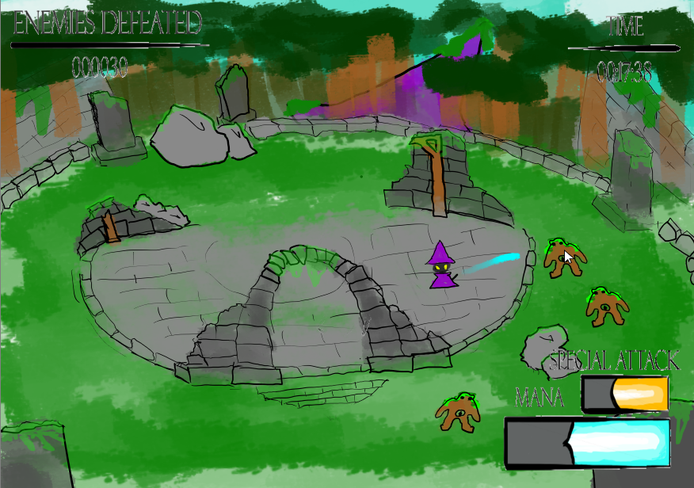
Gameplay Mockup

Slide 5
Risk Analysis and Stretch Goals
Most of the risk comes from included the effects of the different attacks and overscoping the design of moves, naimly the Super Attack. Stretch goals include:
Adding different effects to the different Special attacks
Making a custom animation and Visual Effect for the Super Attack
Creating multiple aesthetic animations for the Wizard and the Golems

Slide 6
Schedule and Production Timeline
Include a breakdown of the Production Timeline. Include Major Milestones and what core features and goals should be complete by each phase.
Pre-Production | Alpha | Beta | Gold
Completed Bibles Build barebones prototype as proof of concept Production schedule | Create more rounded out version of the playable demo Hunt for bugs and glitches | Create mostly finalized product Squash any bugs found before releases | Release full game with minimal or no bugs

Slide 7
Team Members and Roles
Present the team members and their main role and responsibilities
Artists | Programming
Jack - Project Management & VFX | Person - Role

Slide 8
Questions?

